Slide 1
Tasteful Panthers: PDH Food Recommendation
Team Members
Alex Laureano
Jiahao Shu
Anthony Hordesky
Lexi Franklin
Faculty Advisor
Phillip Chan

Slide 2
Why?
Goal
Provide personalized dining recommendations for guests at Panther Dining Hall (PDH)
Motivation
Improve the campus dining experience by simplifying meal decisions
Provide a connected platform for food reviews and guest interactions
Allow guests to report food issues directly to PDH staff

Slide 3
Approach
Recommendations
Guests receive tailored meal suggestions based on:
Dietary restrictions/preferences
Past meal choices and food reviews
Ensures guests are immediately aware of dining options suited to them
Notifications sent upon arrival at PDH

Slide 4
Approach
Reviews
Guests can leave feedback on meals:
Text reviews, images/videos, star ratings, and tags
Highlight issues or share satisfactions
Reviews help other guests make informed decisions
Notifications remind guests to review meals halfway through meal at PDH

Slide 5
Approach
Contests & Leaderboards
Top Review of the Week: Based on positive ratings received from other uses
Tomorrow’s Prediction: Predict the highest-rated food item for the next day
Games boost engagement and foster a community for the app

Slide 6
Platforms & Tools
Programming Language: Dart (Flutter’s iOS & Android language)
IDE: VSCode
Database & Encryption: Google Firebase Database
Web Scraping: Python web scraper ran on DB machine.
Phone Emulation: Android Studio

Slide 7
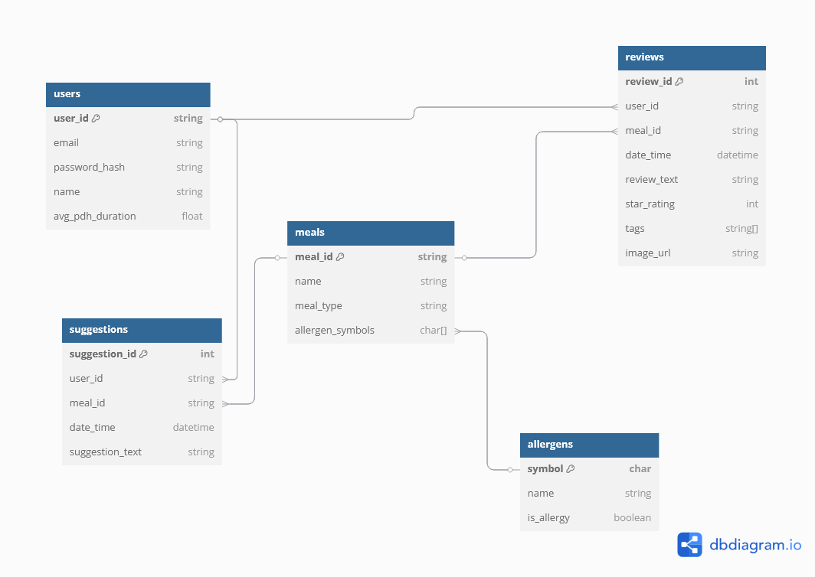
Database Entity-Relationship Diagram

Slide 8
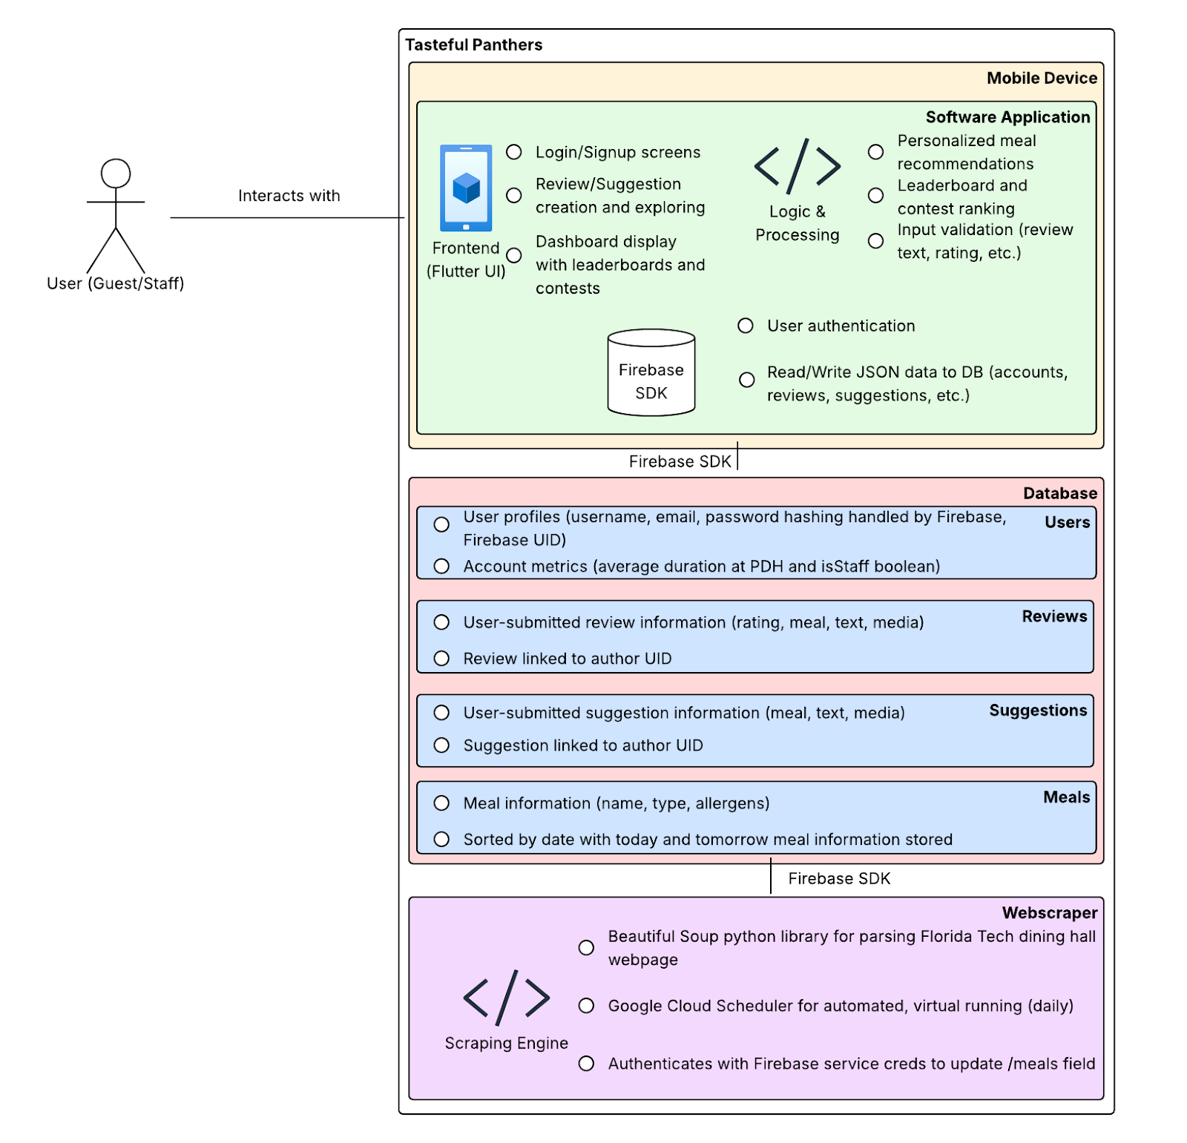
System Architecture Diagram

Slide 9
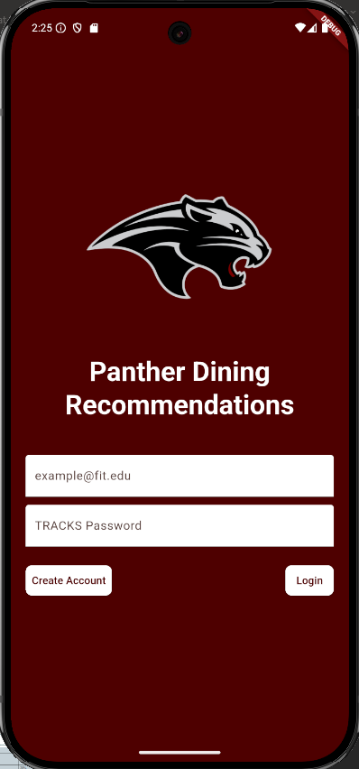
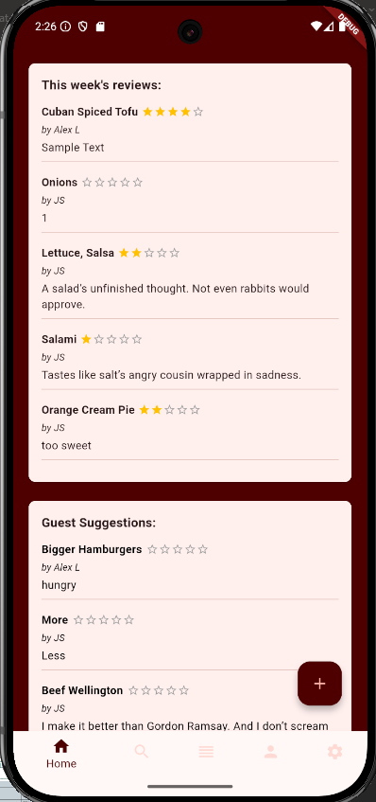
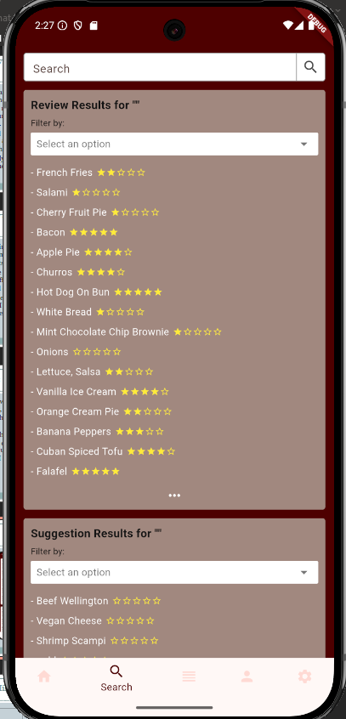
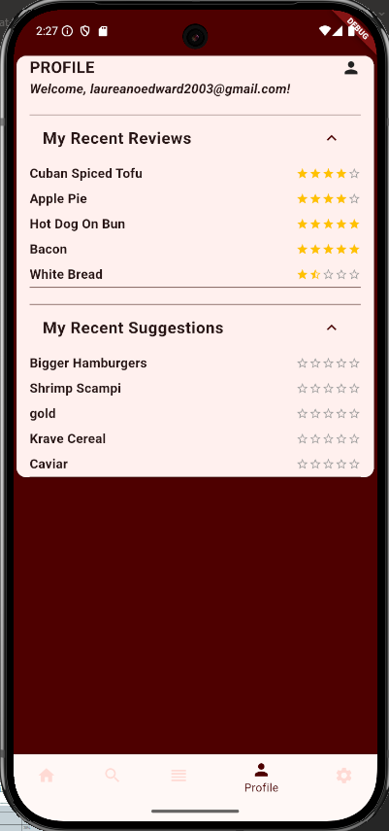
App Screens
Log In Screen
Home Screen
Search Screen
Profile Screen

Slide 10
Progress Summary
Strong and tested foundation has been built
Expanding foundation to allow staff to handle issues and contests should not be a large hurdle at all
Greater efforts are focused on active polish and testing going forward so that our final product isn’t plagued by bugs.

Slide 11
Milestone 4 (Sep 29)
Incorporate video and quicker food finding functionality into reviews
Enable review filtering via star ratings, tags, keywords, etc.
Notify user when entering PDH and when halfway through meal
Update user profile to include favorite dishes and improve general profile display
Implement personalized meal recommendation via ‘Tasteful Twin’ metric

Slide 12
Milestone 5 (Oct 27)
Implement full staff view and functionality
Release demo app for user testing
Test and debug GPS function
Design and begin leaderboard/contest implementation
Demo guest dashboard with all main components

Slide 13
Milestone 6 (Nov 24)
Create Poster
Fully implement contest and leaderboard functionality
Test all app features and functions
Implement extra features/platforms

Slide 14
Milestone 4 Task Matrix
Task | Alex | Anthony | Jiahao | Lexi
Notifications | 0% | 100% | 0% | 0%
Writing Reviews | 100% | 0% | 0% | 0%
Reading/Searching Reviews | 0% | 0% | 100% | 0%
User Profile | 0% | 0% | 0% | 100%
Recommendation Algorithm | 25% | 25% | 25% | 25%

Slide 15
Conclusion
Questions?

